Slide 1
Applied Machine Learning SEZG568/SSZG568
Dr Y V K RAVI KUMAR
yvk.ravikumar@pilani.bits-pilani.ac.in

Slide 2
Session 9(30th September,2023)

Slide 3
Session 9 – 30th September,2023
9 | Classification Models II: Decision Tree. Entropy and information gain. Construction algorithm. Challenges with Decision Tree | T1: Chapter 6 T2: Chapter 4

Slide 4
Session Content
Module-6
Classification Models II
Decision Tree
Entropy
Information gain
Challenges with Decision tree

Slide 5
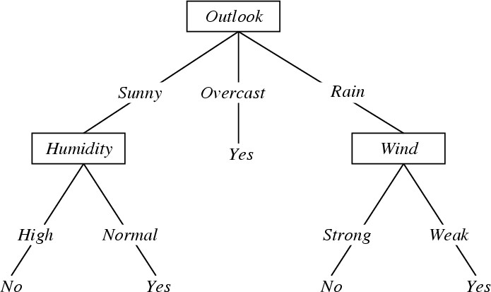
Decision Tree Learning
Problem Setting:
Set of possible instances X
each instance x in X is a feature vector
e.g., <Humidity=low, Wind=weak, Outlook=rain, Temp=hot>
Unknown target function f : X→Y
Y is discrete valued
Set of function hypotheses H={ h | h : X→Y }
each hypothesis h is a decision tree
trees sorts x to leaf, which assigns y
Notes:
Each node represents a test on an attribute of the instance to be classified and each outgoing arch a possible outcome, leading to a further test.
The leafs correspond to classification actions. A binary classification in this case.
The instance <Outlook=Sunny, Temp=Hot, Humidity=High, Wind=Strong> is classified as No.

Slide 6
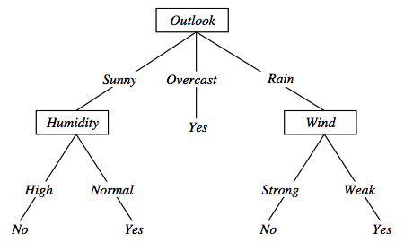
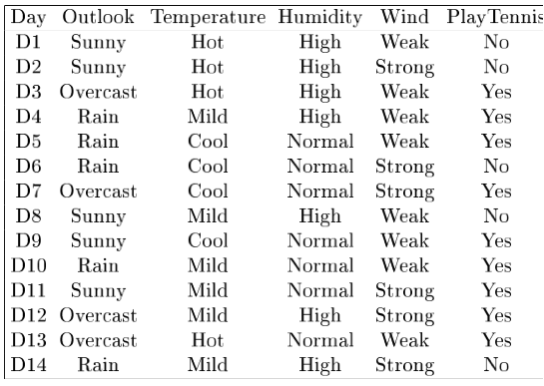
Decision tree representation (PlayTennis)
〈Outlook=Sunny, Temp=Hot, Humidity=High, Wind=Strong〉? No
Notes:
Each node represents a test on an attribute of the instance to be classified and each outgoing arch a possible outcome, leading to a further test.
The leafs correspond to classification actions. A binary classification in this case.
The instance <Outlook=Sunny, Temp=Hot, Humidity=High, Wind=Strong> is classified as No.

Slide 7
Decision trees expressivity
Decision trees represent a disjunction of conjunctions on constraints on the value of attributes
(Outlook = Sunny ∧ Humidity = Normal) ∨
(Outlook = Overcast) ∨
(Outlook = Rain ∧ Wind = Weak)
How to choose the best attribute?

Slide 8
Choosing the Best Attribute
Key problem: choosing which attribute to split a given set of examples
Some possibilities are:
Random: Select any attribute at random
Least-Values: Choose the attribute with the smallest number of possible values
Most-Values: Choose the attribute with the largest number of possible values
Max-Gain: Choose the attribute that has the largest expected information gain
i.e., attribute that results in smallest expected size of subtrees rooted at its children
The ID3 algorithm uses the Max-Gain method of selecting the best attribute

Slide 9
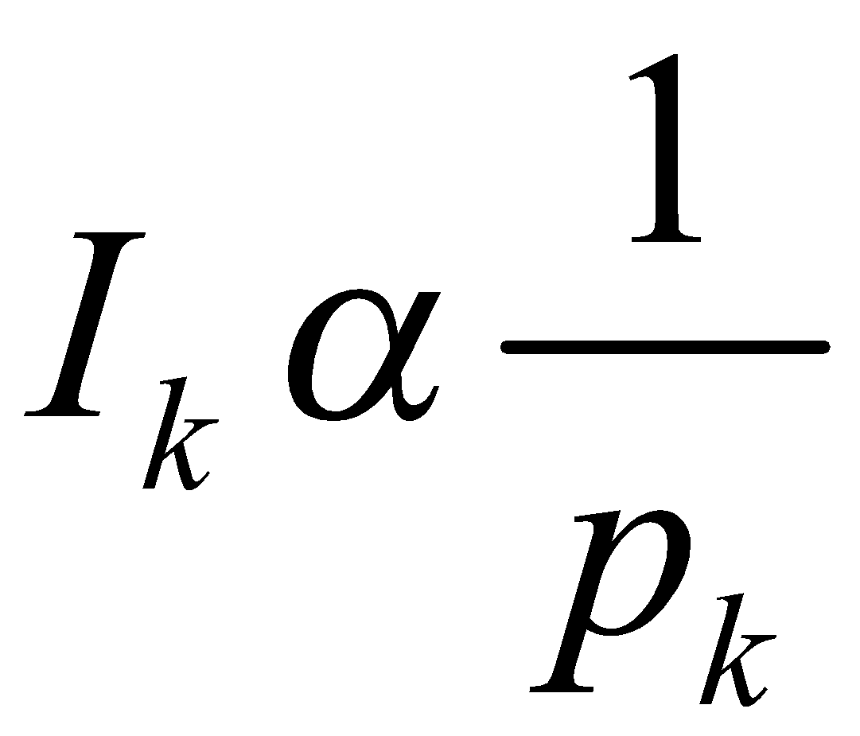
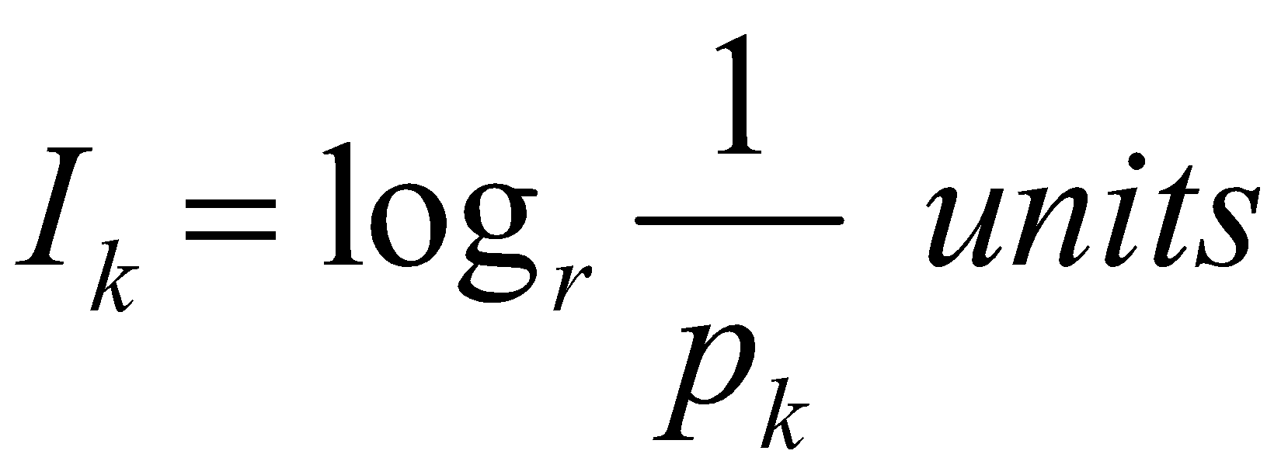
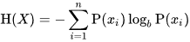
Measure of Information and Entropy
The amount of information (surprise element) conveyed by a message is inversely proportional to its probability of occurrence. That is
The mathematical operator satisfies above properties is the logarithmic operator.
Entropy of discrete random variable X={x₁, x₂…x_{n}}
since: log₂(1/P(event))= -log₂P(event)
As uncertainty increases, entropy increases
Entropy across all values

Slide 10
Entropy in general
Entropy measures the amount of information in a random variable
For binary classification [two-valued random variable]
H(X) = – p₊ log₂ p₊ – p– log₂ p– X = {+, –}
For classification in c classes
c c
H(X) = – Σ p_{i} log₂ p_{i} = Σ p_{i} log₂ 1/ p_{i} X = {i, …, c}
i=1 i=1

Slide 11
Information gain
Which test is more informative?
Split over whether Balance exceeds 50K
Split over whether applicant is employed
Less or equal 50K
Over 50K
Unemployed
Employed

Slide 12









Information gain
Impurity/Entropy (informal)
Measures the level of impurity in a group of examples

Slide 13





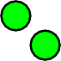
Information gain
Impurity
Very impure group
Less impure
Minimum impurity

Slide 14
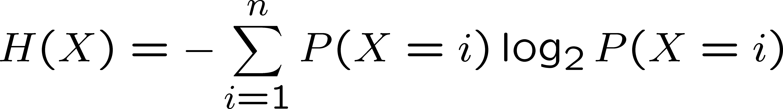
Information gain
Entropy: a common way to measure impurity
# of possible values for X
Entropy H(X) of a random variable X
H(X) is the expected number of bits needed to encode a randomly drawn value of X(under most efficient code)

Slide 15
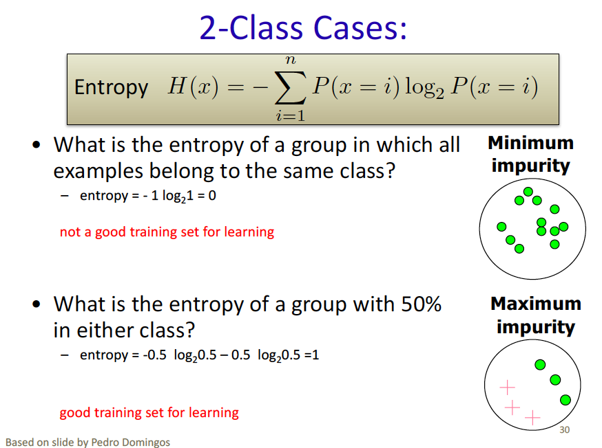
Information gain

Slide 16
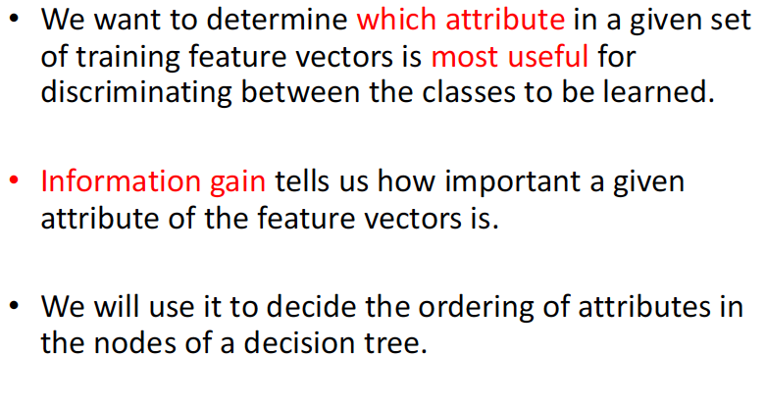
Information gain

Slide 17
Entropy in binary classification
Entropy measures the impurity of a collection of examples. It depends from the distribution of the random variable p.
S is a collection of training examples
p₊ the proportion of positive examples in S
p– the proportion of negative examples in S
Entropy (S) ≡ – p₊ log₂ p₊ – p–log₂ p– [0 log₂0 = 0]
Entropy ([14+, 0–]) = – 14/14 log₂ (14/14) – 0 log₂ (0) = 0
Entropy ([9+, 5–]) = – 9/14 log₂ (9/14) – 5/14 log₂ (5/14) = 0.94
Entropy ([7+, 7– ]) = – 7/14 log₂ (7/14) – 7/14 log₂ (7/14) = 1/2 + 1/2 = 1
Note: the log of a number < 1 is negative, 0 ≤ p ≤ 1, 0 ≤ entropy ≤ 1
Notes:
S=[9+, 5-] una collezione di esempi di cui 9 positivi e 5 negativi

Slide 18
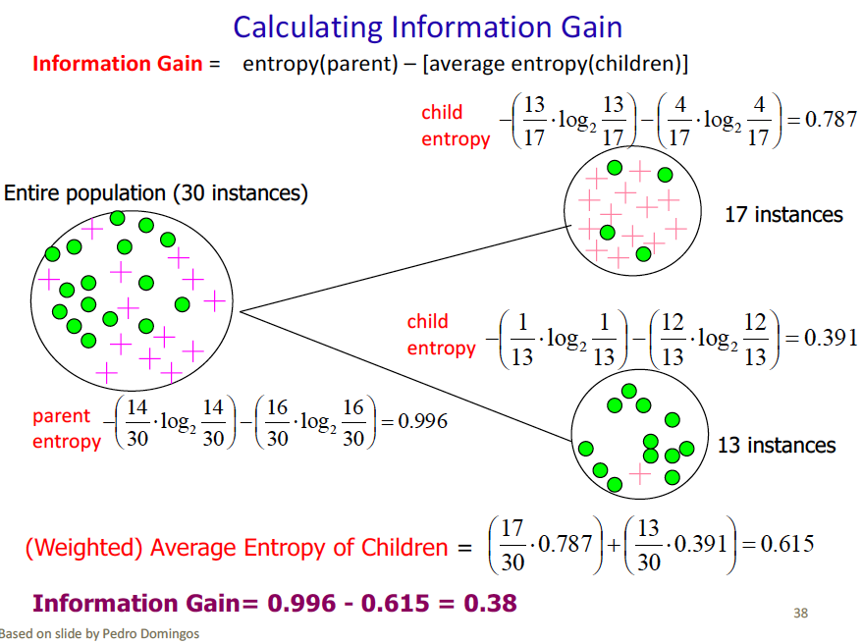
Information gain

Slide 19
Information gain as entropy reduction
Information gain is the expected reduction in entropy caused by partitioning the examples on an attribute.
The higher the information gain the more effective the attribute in classifying training data.
Expected reduction in entropy knowing A
Gain(S, A) = Entropy(S) − Σ Entropy(S_{v})
v ∈ values(A)
values(A) possible values for A
S_{v} subset of S for which A has value v
|Sv|
|S|
Notes:
La riduzione in entropia attesa partizionando sui valori dell’ attributo A

Slide 20
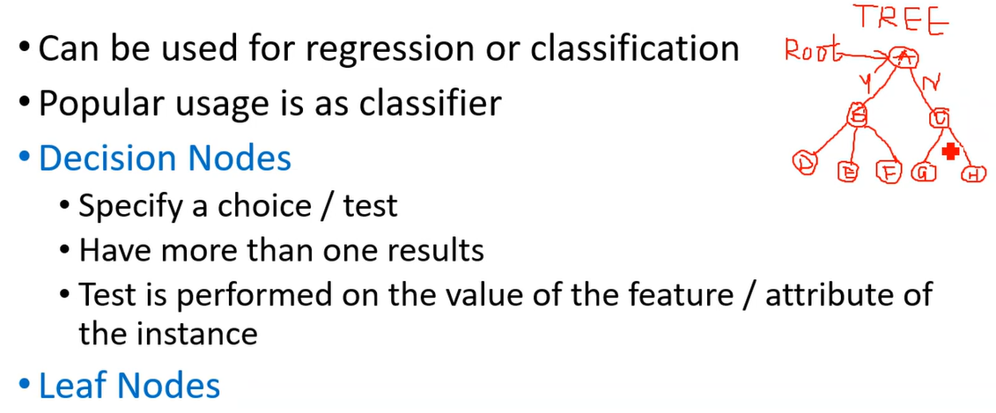
Decision Tree

Slide 21
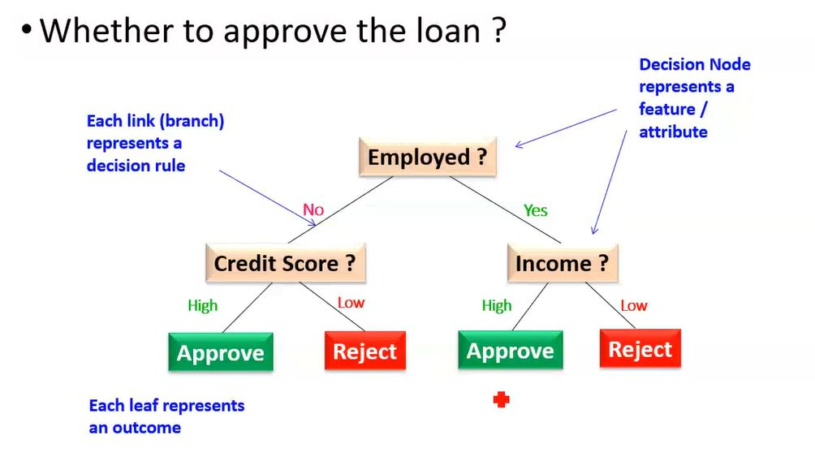
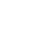
Decision Tree - Example

Slide 22
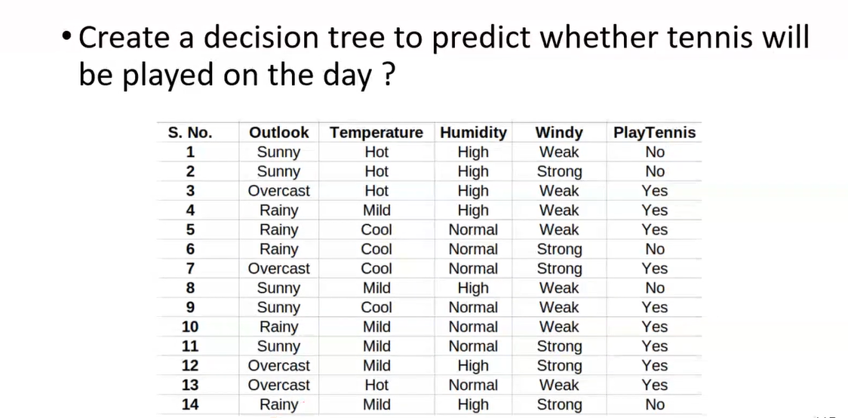
Example

Slide 23
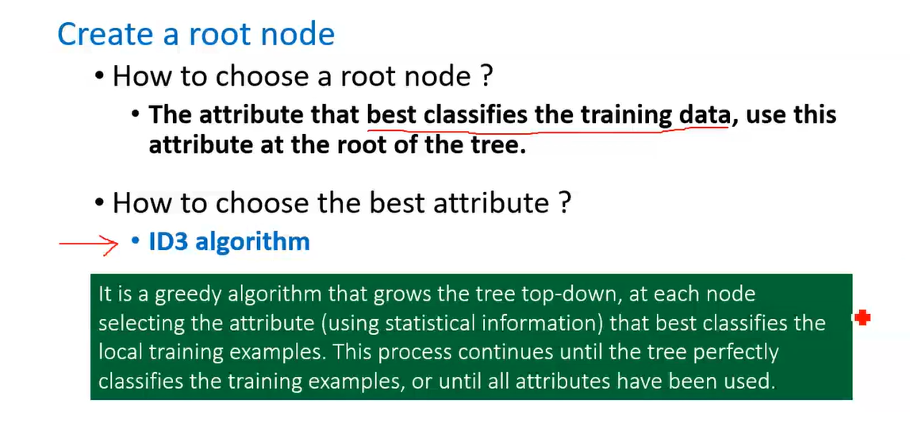
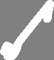
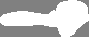
How to Proceed?

Slide 24
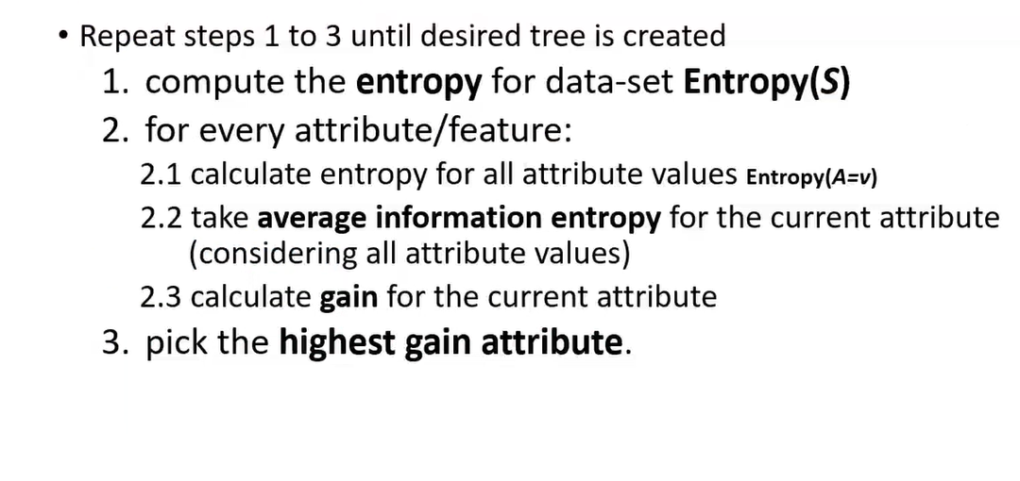
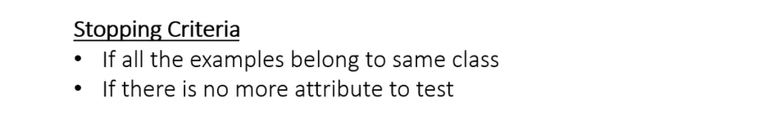
ID3 Algorithm

Slide 25
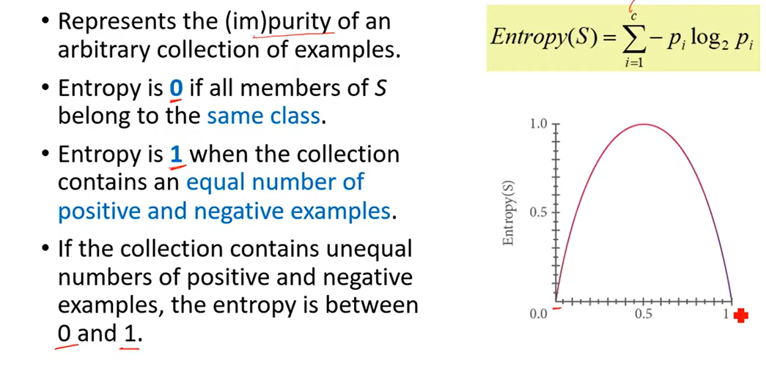
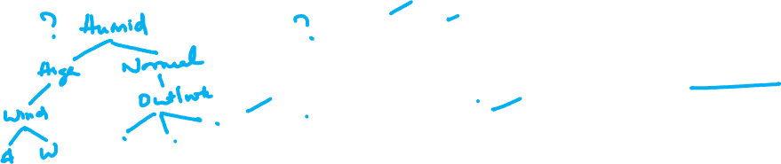
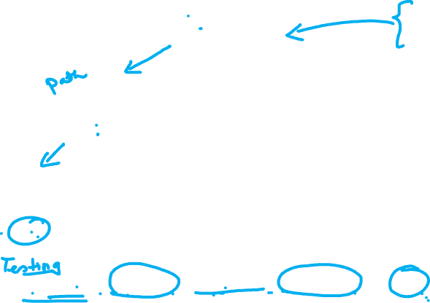
Entropy

Slide 26
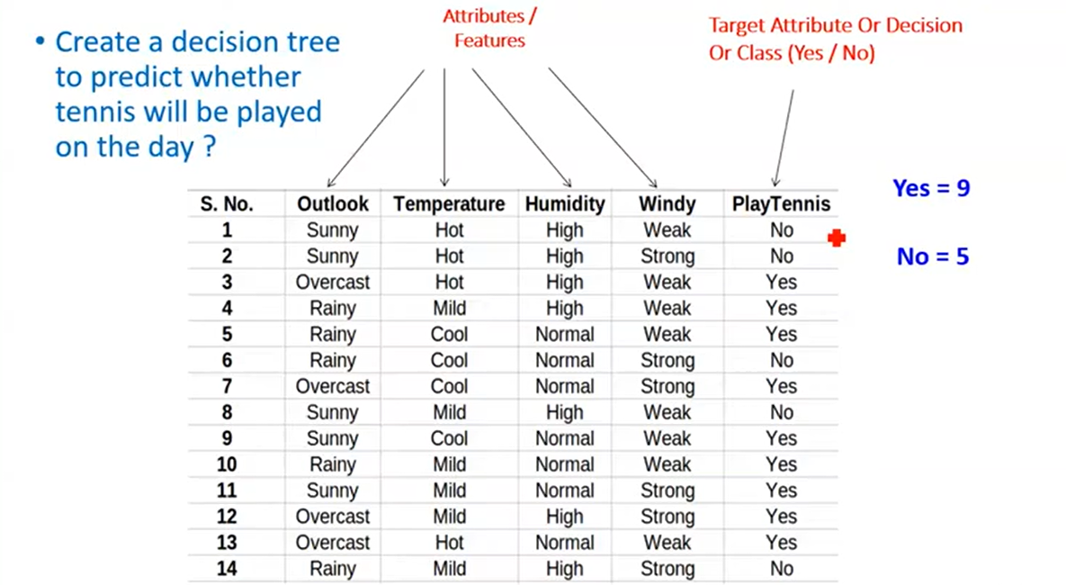

Slide 27
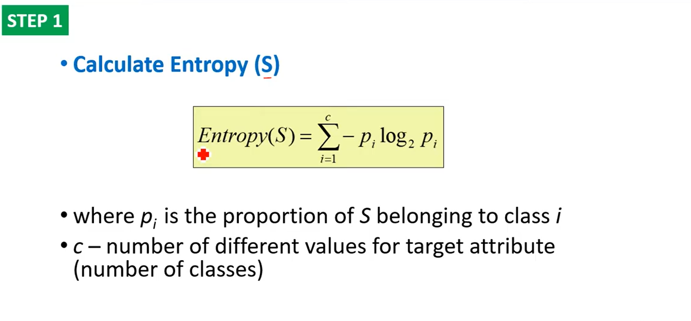
Step 1

Slide 28
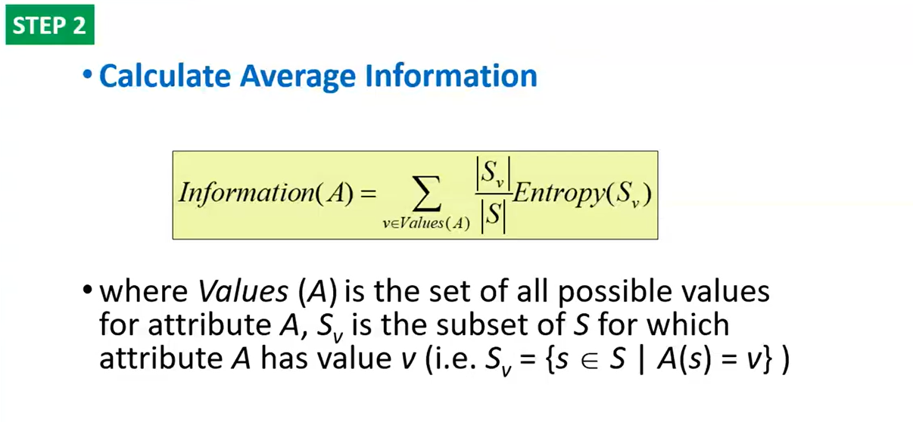
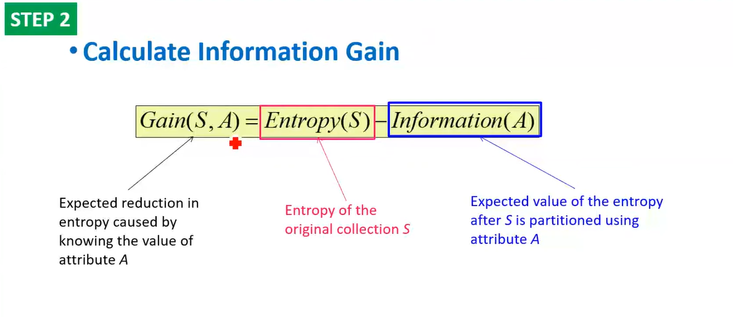
Step 2

Slide 29
SOLUTION

Slide 30
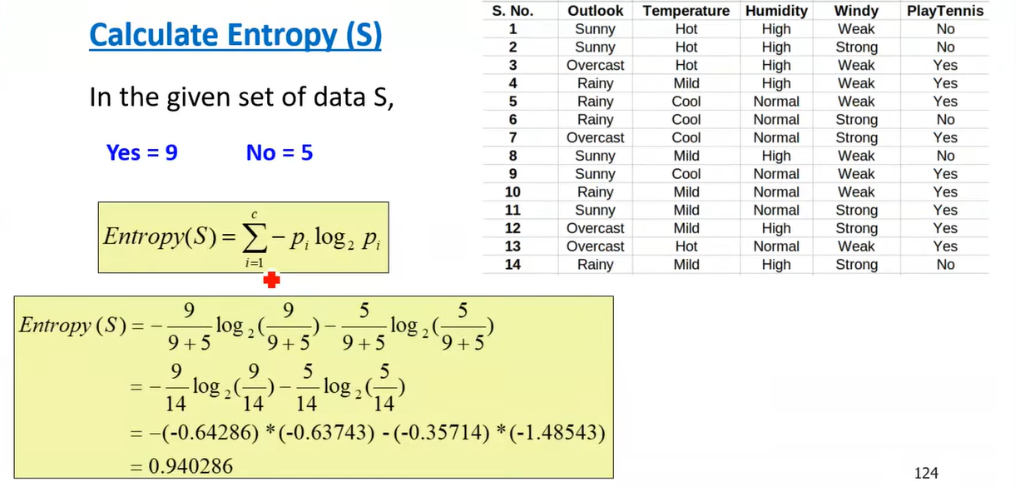
Step 1

Slide 31
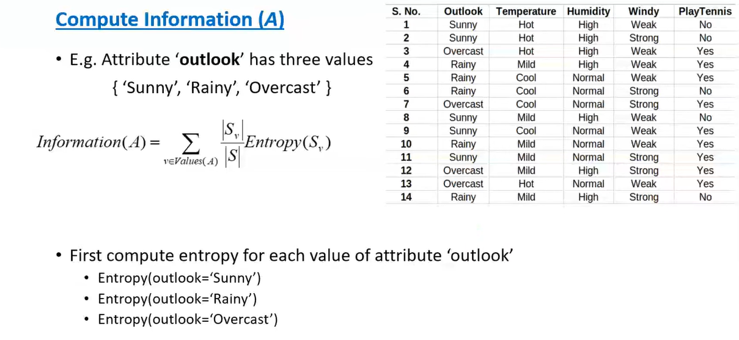
Step 2

Slide 32
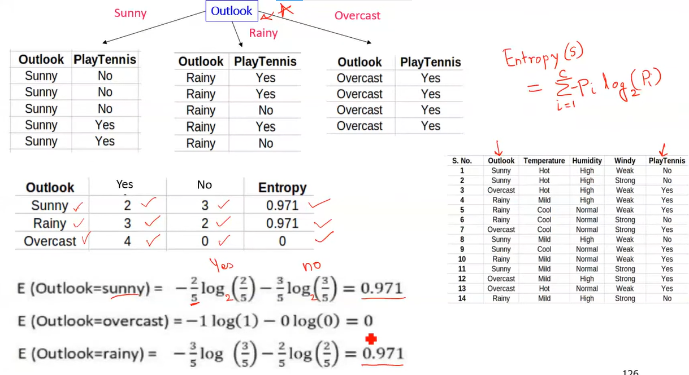

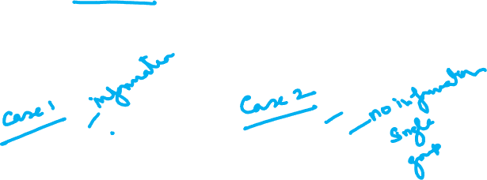
Step 2

Slide 33
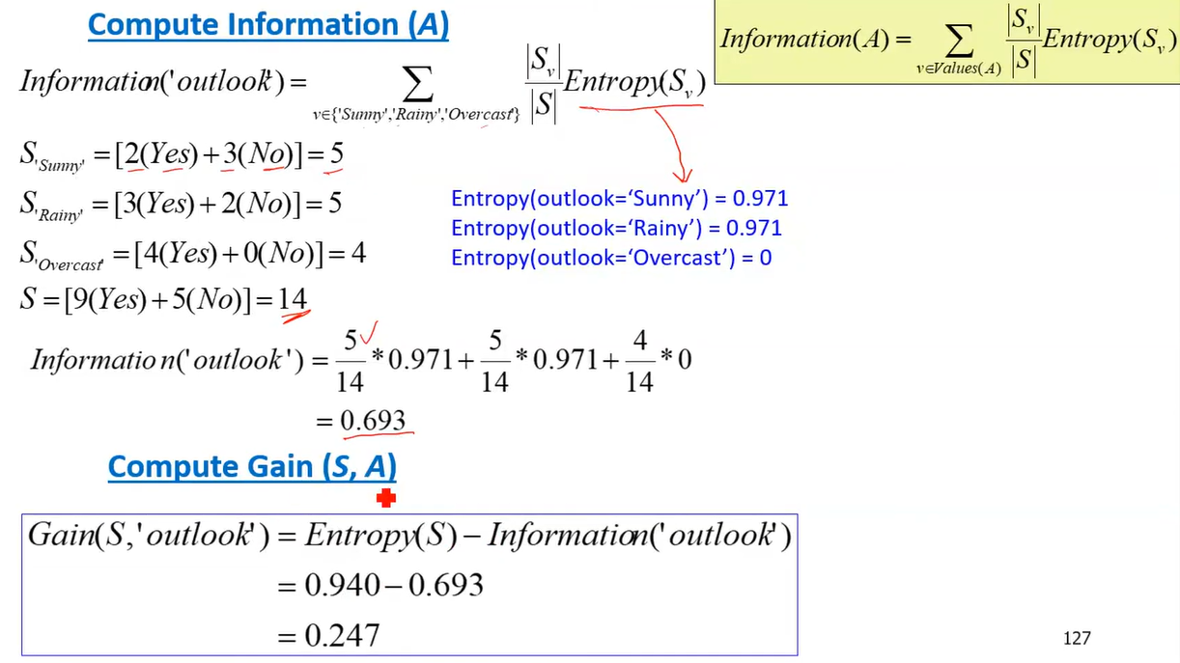
Step 2

Slide 34
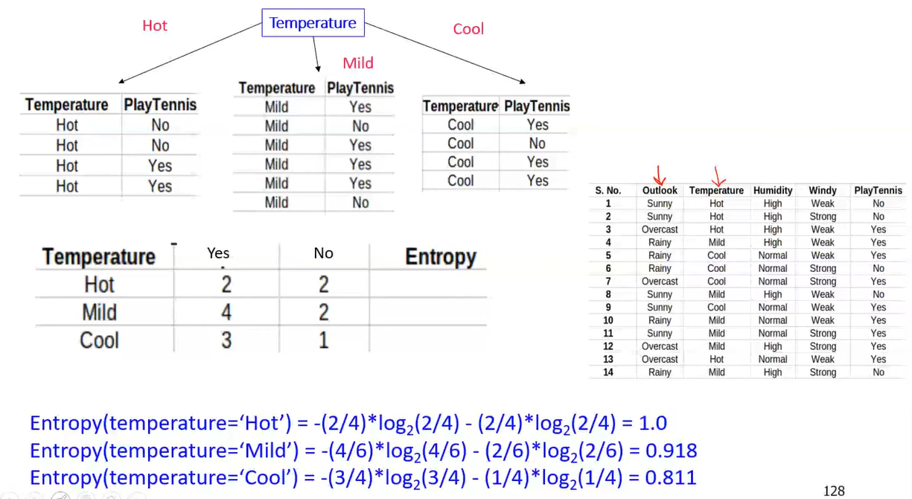
Step 2

Slide 35
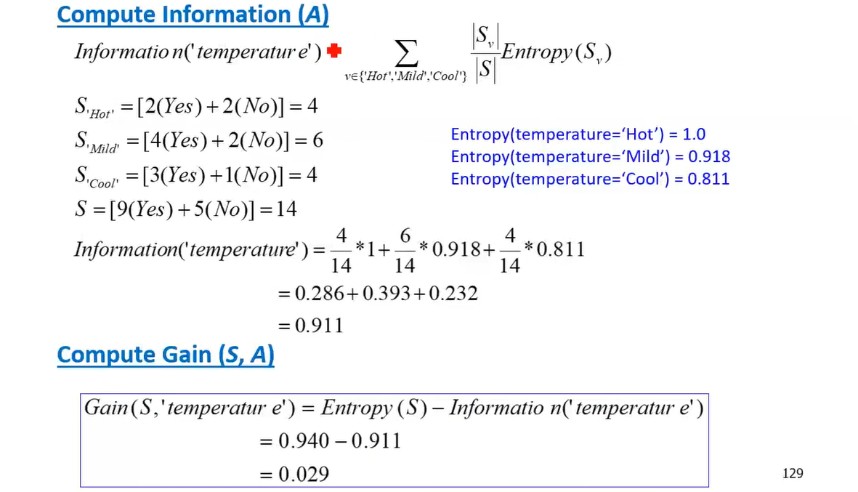
Step 2

Slide 36
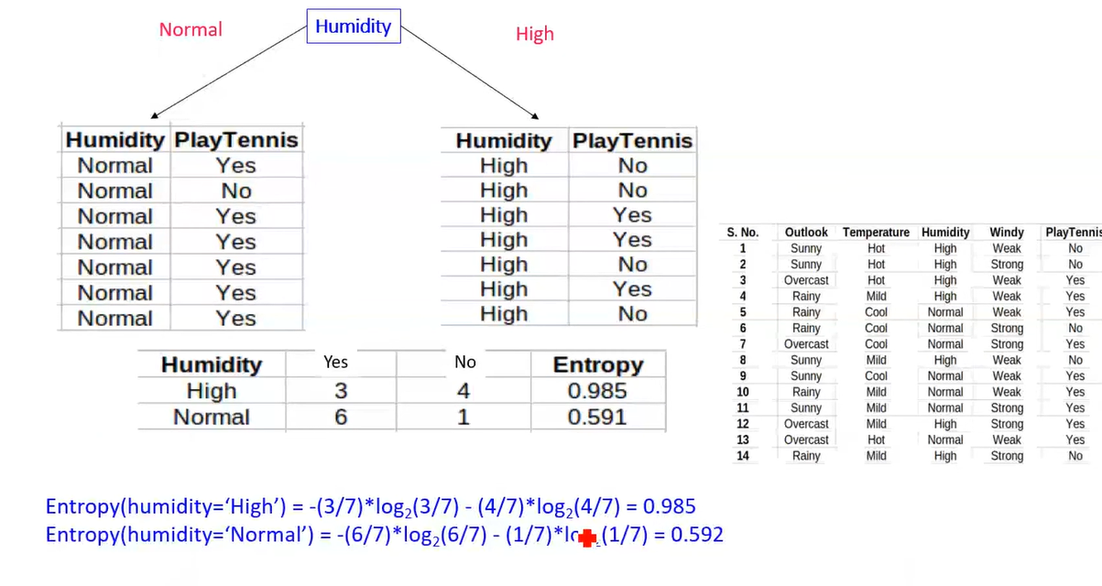
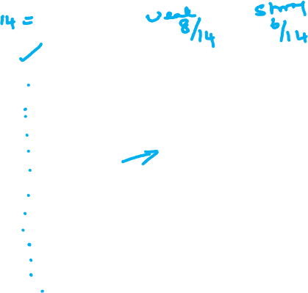
Step 2

Slide 37
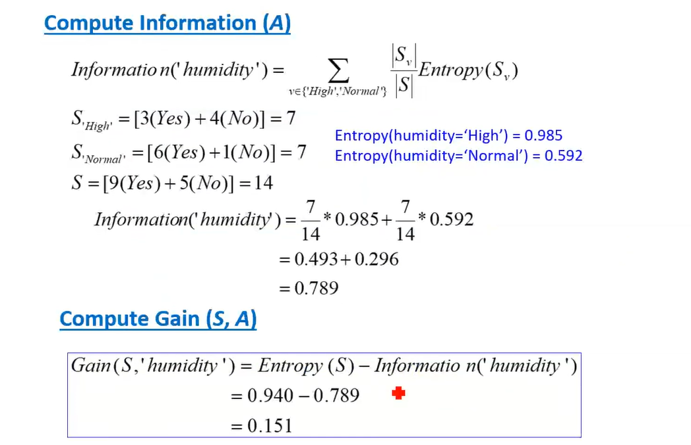
Step 2

Slide 38
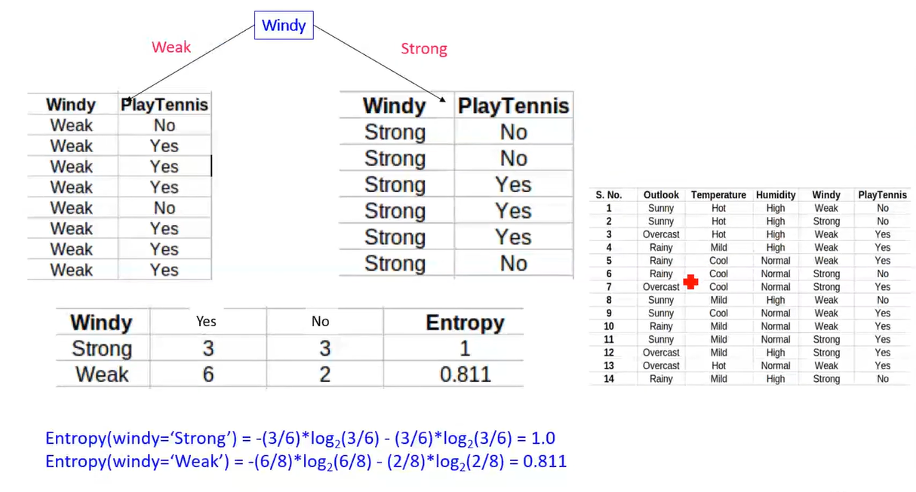
Step 2

Slide 39
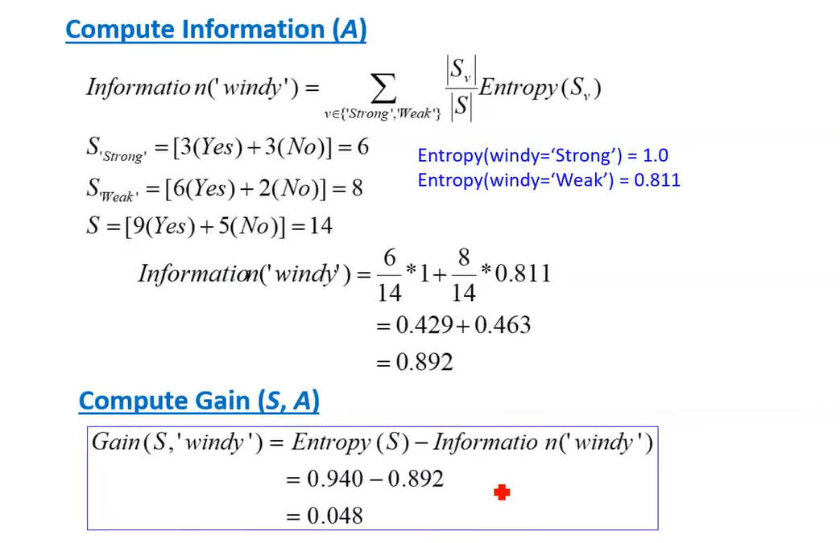
Step 2

Slide 40
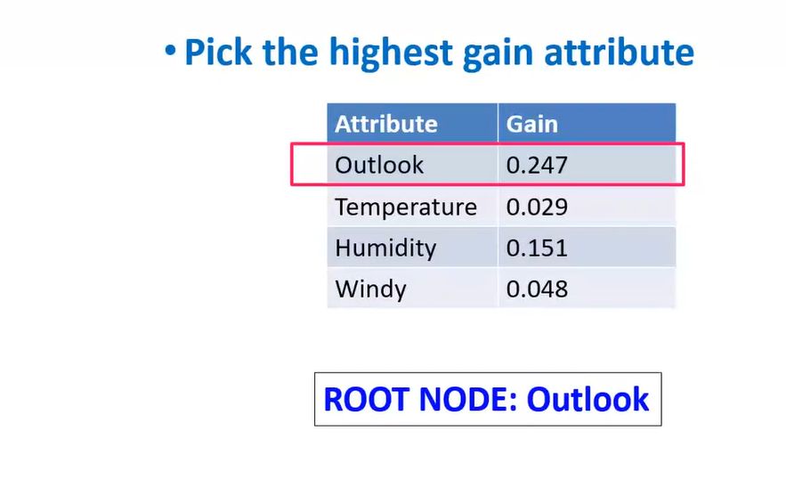
Step 3

Slide 41
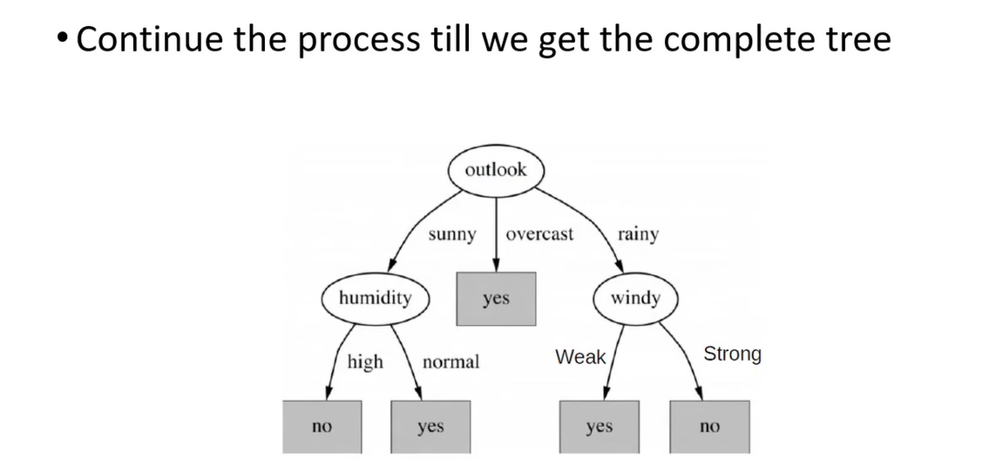
Continue until we get a complete tree

Slide 42
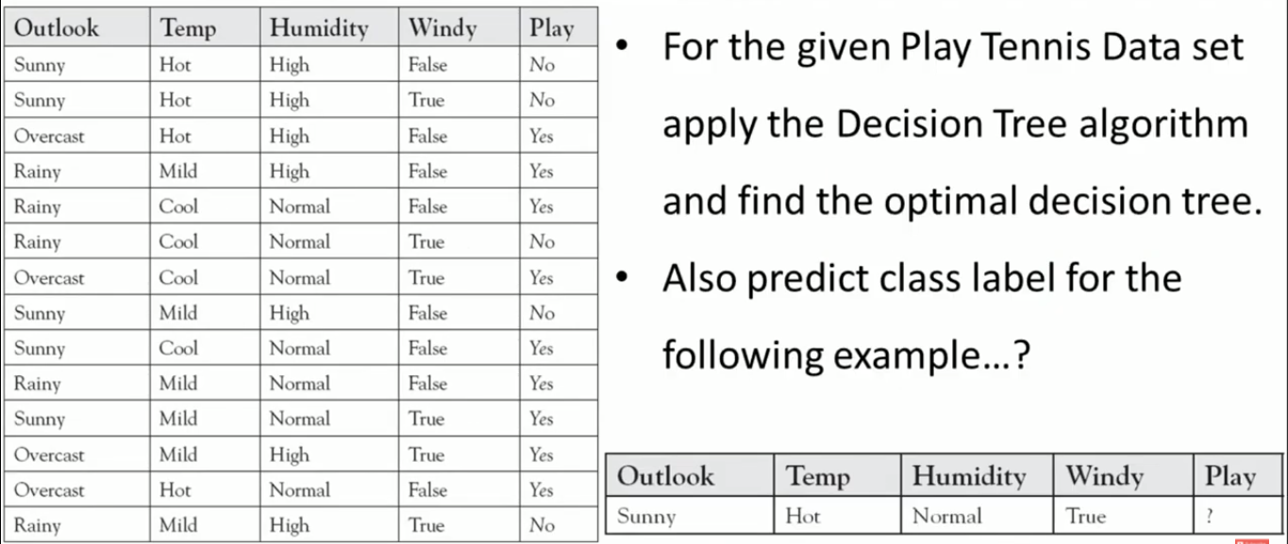
CART-Example 1

Slide 43
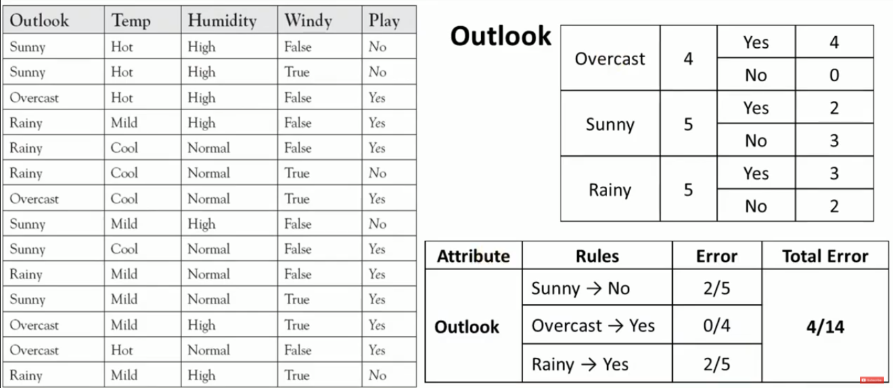
Example 1

Slide 44
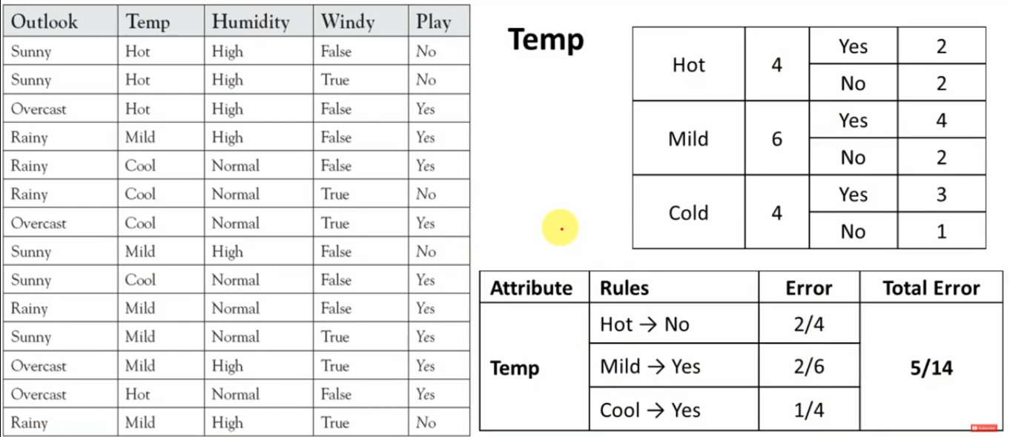
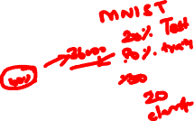
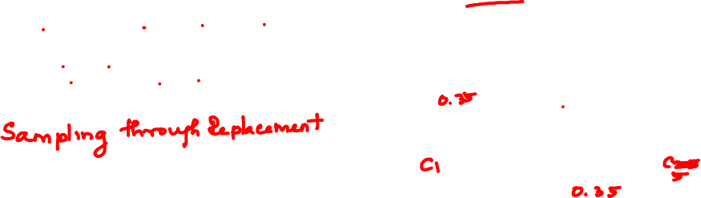
Example 1
/Yes

Slide 45
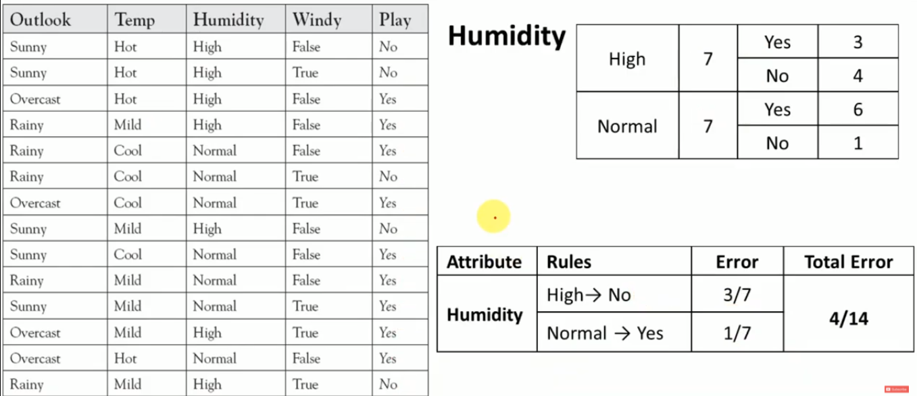
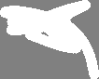
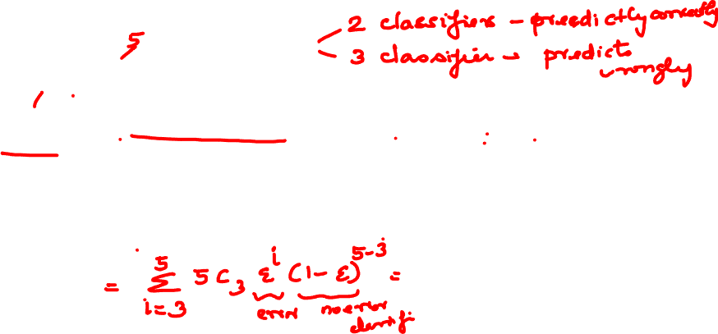
Example 1

Slide 46
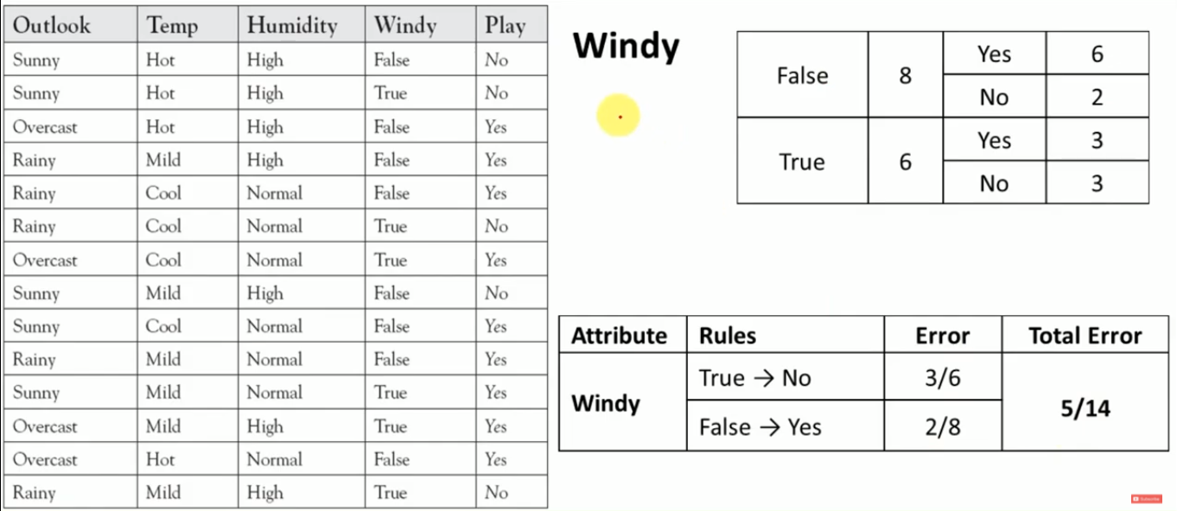


Example 1
/Yes

Slide 47



Example 1

Slide 48






Example 1

Slide 49


Example 1
/Yes
/No

Slide 50




Example 1
/No
/Yes

Slide 51


Example 1

Slide 52



Example 1

Slide 53


Example 2

Slide 54



Example 2

Slide 55



Example 2

Slide 56


Example 2

Slide 57


Example 2

Slide 58


Example 2

Slide 59

Example 2

Slide 60


Example 2

Slide 61



Example 2

Slide 62

Example 3

Slide 63


Example 3

Slide 64



Example 3

Slide 65


Example 3

Slide 66


Example 3

Slide 67


Example 3

Slide 68


Example 3

Slide 69

Example 3

Slide 70

Example 3

Slide 71

Example 3

Slide 72

Example 3

Slide 73

Example 3

Slide 74






Example 3

Slide 75


Example 3

Slide 76

Inductive Bias in ID3 Decision Tree Learning

Slide 77

Issues in Decision Tree Learning

Slide 78

Issues in Decision Tree Learning

Slide 79

Issues in Decision Tree Learning

Slide 80

Issues in Decision Tree Learning

Slide 81

Issues in Decision Tree Learning

Slide 82

Issues in Decision Tree Learning

Slide 83

Issues in Decision Tree Learning

Slide 84

Issues in Decision Tree Learning

Slide 85

Issues in Decision Tree Learning

Slide 86

Issues in Decision Tree Learning

Slide 87

Issues in Decision Tree Learning

Slide 88

Issues in Decision Tree Learning

Slide 89
Prefer shorter hypotheses: Occam's razor
Why?
Occam's razor says that when presented with competing hypotheses that make the same predictions, one should select the solution which is simple“
Arguments in favor
There are fewer short hypotheses than long ones
If a short hypothesis fits data unlikely to be a coincidence
Elegance and aesthetics
Arguments against
Not every short hypothesis is a reasonable one.

Slide 90


Prefer shorter hypotheses: Occam's razor
Why?

Slide 91
Issues in decision trees learning
Overfitting
Reduced error pruning
Rule post-pruning
Extensions
Problem with Information Gain measure
Continuous valued attributes
Handling training examples with missing attribute values
Notes:
L'overfitting può succedere quando c' è rumore nei dati.

Slide 92
Example
D15 Sunny Hot Normal Strong No
Notes:
L’ esempio D15 è sbagliato, introduce rumore nei dati.

Slide 93


Overfitting in decision trees
〈Outlook=Sunny, Temp=Hot, Humidity=Normal, Wind=Strong, PlayTennis=No 〉
This new example causes splitting of second leaf node.
Notes:
The example shows that noise can lead to overfitting.
Overfitting without noise is also possible, especially when classifcation decision on the leafs are based on few examples. Uniform classification may be a coincidence.
This is a potential cause of overfitting.
Overfitting is a significant problem for DT, reducing the accuracy to 10-25% on many problems.

Slide 94

Avoid overfitting in Decision Trees
Two strategies:
Stop growing the tree earlier, before perfect classification
Leaf nodes are impure
Allow the tree to overfit the data, and then post-prune the tree
Training and validation set
split the training in two parts (training and validation) and use validation to assess the utility of post-pruning
Reduced error pruning
Rule post pruning
Notes:
Usando tutti dati di training, un test statistico può predire l’ influenza delle decisioni se espandere (o potare) sulle prestazioni su tutto X.
Minimum description length principle, un principio di compattezza della rappresentazione.

Slide 95
Reduced-error pruning
Each node is a candidate for pruning
Pruning consists in removing a subtree rooted in a node
the node becomes a leaf and is assigned the most common classification
Nodes are removed only if the resulting tree performs no worse on the validation set.
Nodes are pruned iteratively
at each iteration the node whose removal increases accuracy the most on the validation set is pruned.
Pruning stops when no pruning increases accuracy
Notes:
Potatura sulla base di errori ridotti, valutati sul validation set.

Slide 96
Reduced-error pruning
Partition training data in “train” and “validation” sets.
Build a complete tree from the “train” data
While pruning doesn’t harm:
For each non leaf node, n in the tree do:
Temporarily prune the subtree below n and replace it with a leaf labelled with the current majority class at that node.
Measure and record the accuracy of the pruned tree on the validation set
4.Permantenly prune the node that in the greatest increase in the accuracy on the validation set.
Notes:
Potatura sulla base di errori ridotti, valutati sul validation set.

Slide 97
Reduced-error pruning
Notes:
Potatura sulla base di errori ridotti, valutati sul validation set.

Slide 98


Reduced-error pruning
Notes:
Potatura sulla base di errori ridotti, valutati sul validation set.

Slide 99
Reduced-error pruning
Drawbacks:
What happens if we have a small dataset?, so that we cannot have enough training set and validation set
Is there a solution?
-Rule post pruning appraoch
https://www.cloudyml.com/blog/decision-tree-pruning-techniques-in-python/
Notes:
Potatura sulla base di errori ridotti, valutati sul validation set.

Slide 100
Rule post-pruning
Create the decision tree from the training set
Convert the tree into an equivalent set of rules
Each path corresponds to a rule
Each node along a path corresponds to a pre-condition
Each leaf classification to the post-condition
Prune (generalize) each rule by removing those preconditions whose removal improves accuracy
over validation set
Sort the rules in estimated order of accuracy, and consider them in sequence when classifying new instances

Slide 101


Converting to rules
5 paths, hence 5 rules
Each node gives precondition
Classification is the post condition
(Outlook=Sunny)∧(Humidity=High) ⇒ (PlayTennis=No)

Slide 102

Rule Post-Pruning
Convert tree to rules (one for each path from root to a leaf)
For each antecedent in a rule, remove it if error rate on validation set does not decrease
Sort final rule set by accuracy
Outlook=sunny ^ humidity=high -> No
Outlook=sunny ^ humidity=normal -> Yes
Outlook=overcast -> Yes
Outlook=rain ^ wind=strong -> No
Outlook=rain ^ wind=weak -> Yes
Compare first rule to:
Outlook=sunny->No
Humidity=high->No
Calculate accuracy of 3 rules based on validation set and pick best version.

Slide 103

Why converting to rules?
Each distinct path produces a different rule
a condition removal may be based on a local (contextual) criterion.
Node pruning is global and affects all the rules
Provides flexibility of not removing entire node
In rule form, tests are not ordered and there is no book-keeping involved when conditions (nodes) are removed
Converting to rules improves readability for humans

Slide 104
Problems with information gain
Natural bias of information gain: it favors attributes with many possible values.
Consider the attribute Date in the PlayTennis example.
Date would have the highest information gain since it perfectly separates the training data.
It would be selected at the root resulting in a very broad tree
Very good on the training, this tree would perform poorly in predicting unknown instances.
Leading to overfitting.
The problem is that the partition is too specific, too many small classes are generated.
We need to look at alternative measures …

Slide 105
An alternative measure: Gain Ratio
c |S_{i} | |S_{i} |
SplitInformation(S, A) ≡ − Σ log₂ i=1 |S | |S |
S_{i} are the sets obtained by partitioning on value i of A
SplitInformation measures the entropy of S with respect to the values of A.
The more uniformly dispersed the data the higher it is.
Gain(S, A)
GainRatio(S, A) ≡
SplitInformation(S, A)
GainRatio penalizes attributes that split examples in many small classes such as Date.
Let |S |=n, Date splits examples in n classes
SplitInformation(S, Date)= −[(1/n log₂ 1/n)+…+ (1/n log₂ 1/n)]= −log₂1/n =log₂n
Compare with A, which splits data in two even classes:
SplitInformation(S, A)= − [(1/2 log₂1/2)+ (1/2 log₂1/2) ]= − [− 1/2 −1/2]=1
Notes:
2^{-x} = 1/2^{x}

Slide 106
Dealing with continuous-valued attributes
Given a continuous-valued attribute A, dynamically create a new attribute A_{c}
A_{c} = True if A < c, False otherwise
How to determine threshold value c ?
Example. Temperature in the PlayTennis example
Sort the examples according to Temperature
Temperature 40 48 | 60 72 80 | 90
PlayTennis No No 54 Yes Yes Yes 85 No
Determine candidate thresholds by averaging consecutive values where there is a change in classification: (48+60)/2=54 and (80+90)/2=85

Slide 107
Handling missing values training data
How to cope with the problem that the value of some attribute may be missing?
The strategy -- use other examples to guess attribute
Assign the value that is most common among the training examples at the node
Assign a probability to each value, based on frequencies, and assign values to missing attribute, according to this probability distribution

Slide 108
Applications
Suited for following classification problems:
Applications whose Instances are represented by attribute-value pairs.
The target function has discrete output values
Disjunctive descriptions may be required
The training data may contain missing attribute values
Real world applications
Biomedical applications
Manufacturing
Banking sector
Make-Buy decisions

Slide 109
Thank You!
In our next session: Ensembles

Slide 110
Session 7
Date – 15th April 2023
(Decision Trees)

